Slide 1
Remotely sensing fluvial gas exchange via SWOT

Slide 2
My background
Fluvial geomorphology/hydrology at large-to-global scales
PhD candidate (entering 4th year) with Colin Gleason at UMass
Dissertation on coupling hydraulic geometry theory with remote sensing and river network models
1) remote sensing of streamflow
2) river network gas evasion models
As of 9/1, have NASA FINESST funding to do this for gas evasion!

Slide 3
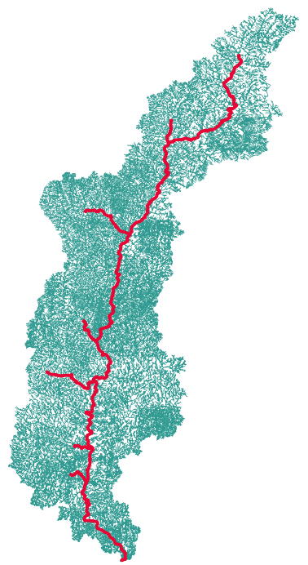
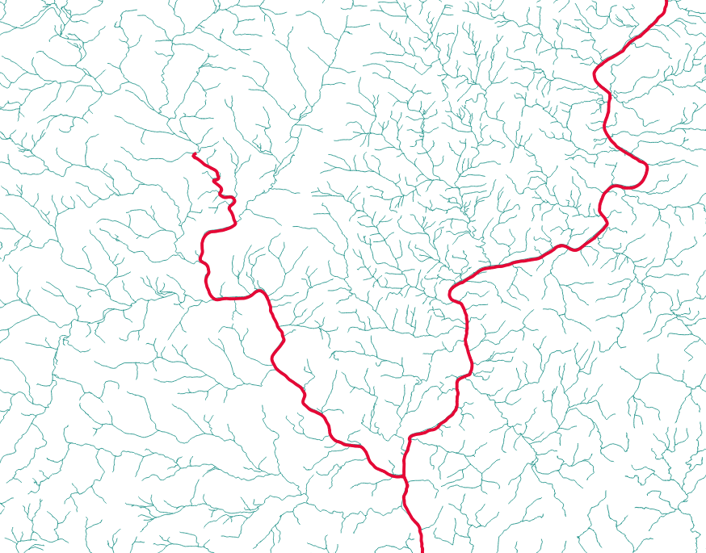
Background: SWOT satellite (launches in 2022)
Measurements:
Water surface elevation
slope
2) River width
Tradeoff:
1) High temporal resolution
-11 day average sampling
-Special 1-day sampling for 6 month calibration in 2022 (including the Connecticut River…)
2) Limited spatial resolution
Rivers > 100m wide (goal is 50m wide)
Brinkerhoff etal (2021) model for the Connecticut (CT) drainage network
SWOT-observable rivers
Notes:
The SWOT satellite, launching in 2021, will measure water surface inundation extent and slope in large rivers and lake surface area in large lakes as unprecedented resolution (every ~11 days)
There are some serious tradeoffs. Green is the network used in our model and red are SWOT observable. While this temporal resolution is great, the tradeoff is a very coarse spatial resolution
Future work will look at coupling the transport model presented here with SWOT observations and a CO2 model to begin process-based study of CO2 evasion at the network scale.

Slide 4
Specific Goals
Remote sensing tools are well-developed and are bread-and-butter of Gleason lab
Gleason & Smith 2014
Hagemann et al 2017
Brinkerhoff et al 2020
But, to robustly use this tool we need a physical model for k that works well in SWOT-observable rivers (i.e. wide)

Slide 5
Remote Sensing
-Borrows heavily from decade+ research on RS of streamflow via SWOT [Gleason & Durand, 2020; Hagemann et al. 2017]

Slide 6
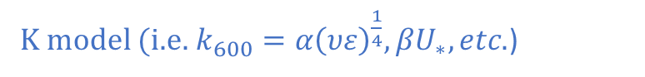
BIKER: ‘Bayesian Inference of the k600 Evasion Rate’ algorithm
K model (i.e.$k_{600}=α{\left(υε\right)}^{\frac{1}{4}}, βU_{∗}, etc.$)
$$p\left(k_{600} | SWOT data\right)=\frac{f\left(SWOT data | k_{600}\right)p\left(k_{600}\right)}{p\left(SWOT data\right)}$$
K600 (and a few other hydraulic terms) are not remotely sensible, so we infer them as statistical parameters that are probabilistically conditional on the SWOT data
BENEFITS
Full uncertainty for each k600 estimate
Informed by priors on k600 and the hydraulic terms

Slide 7
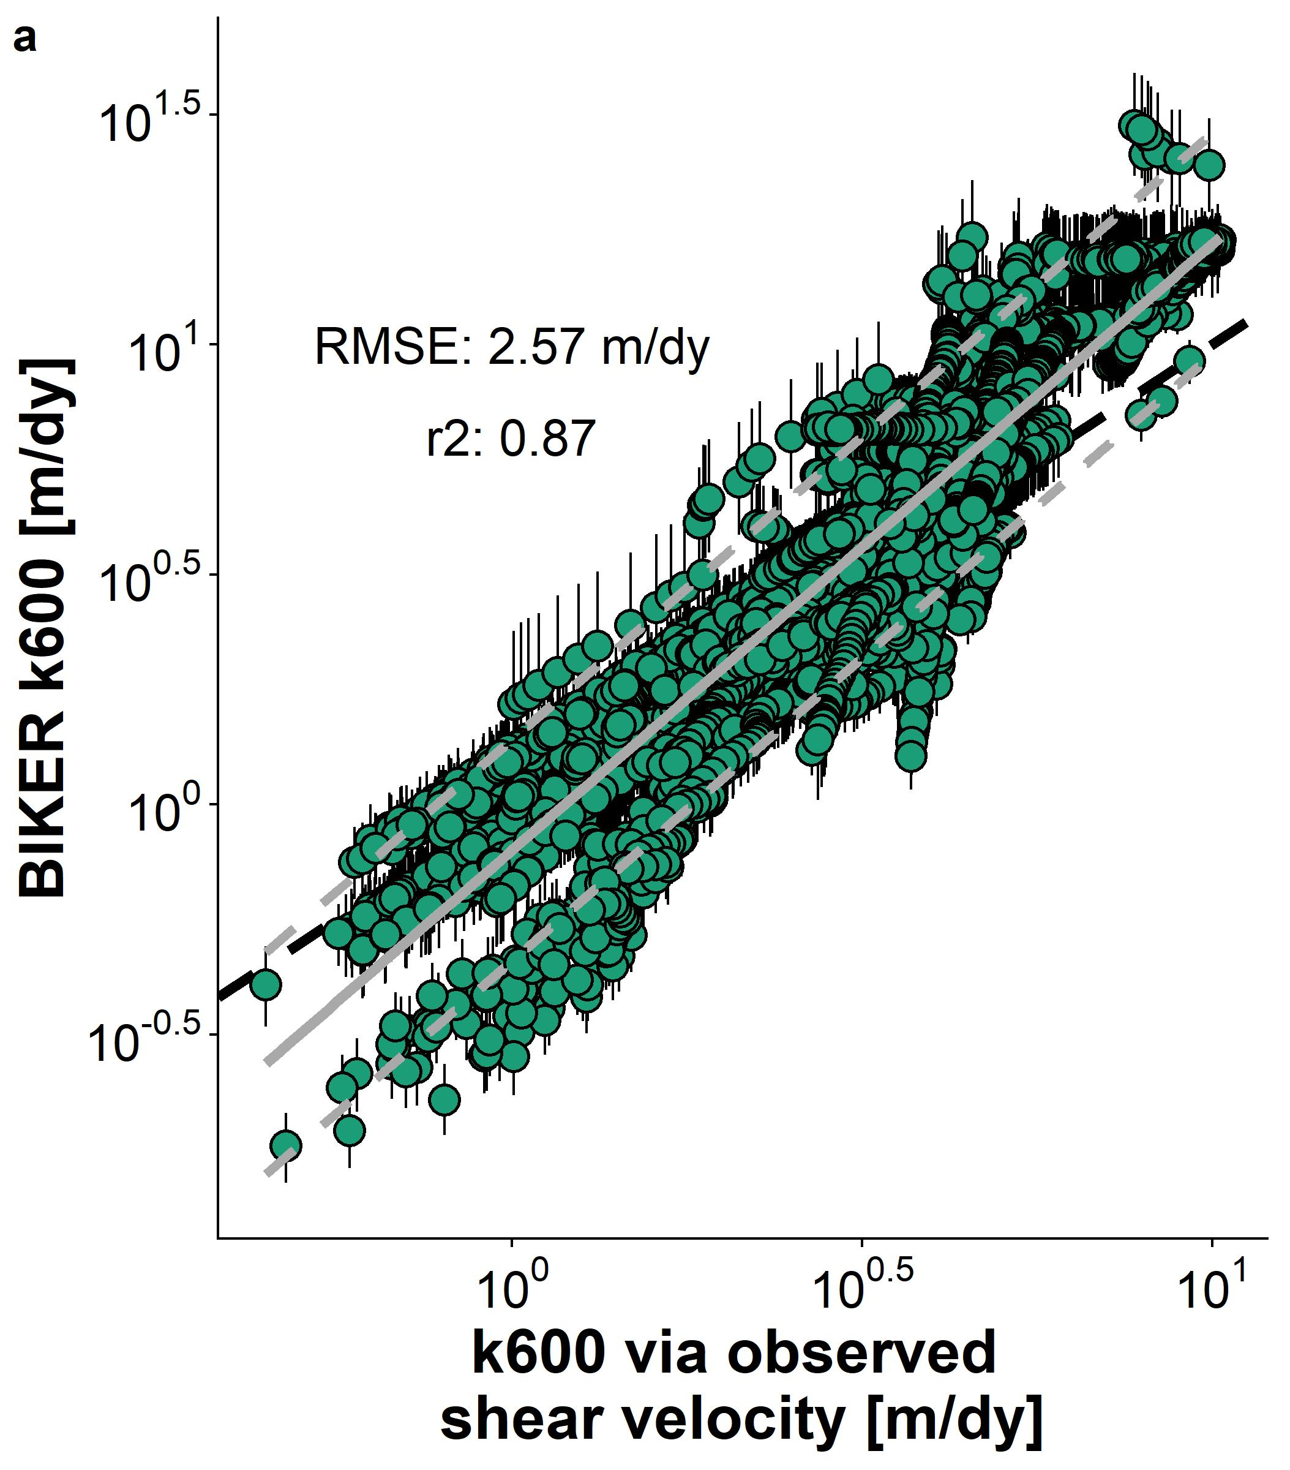
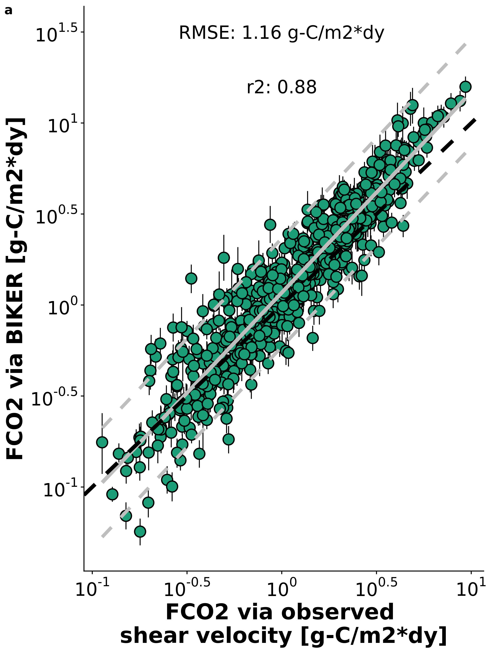
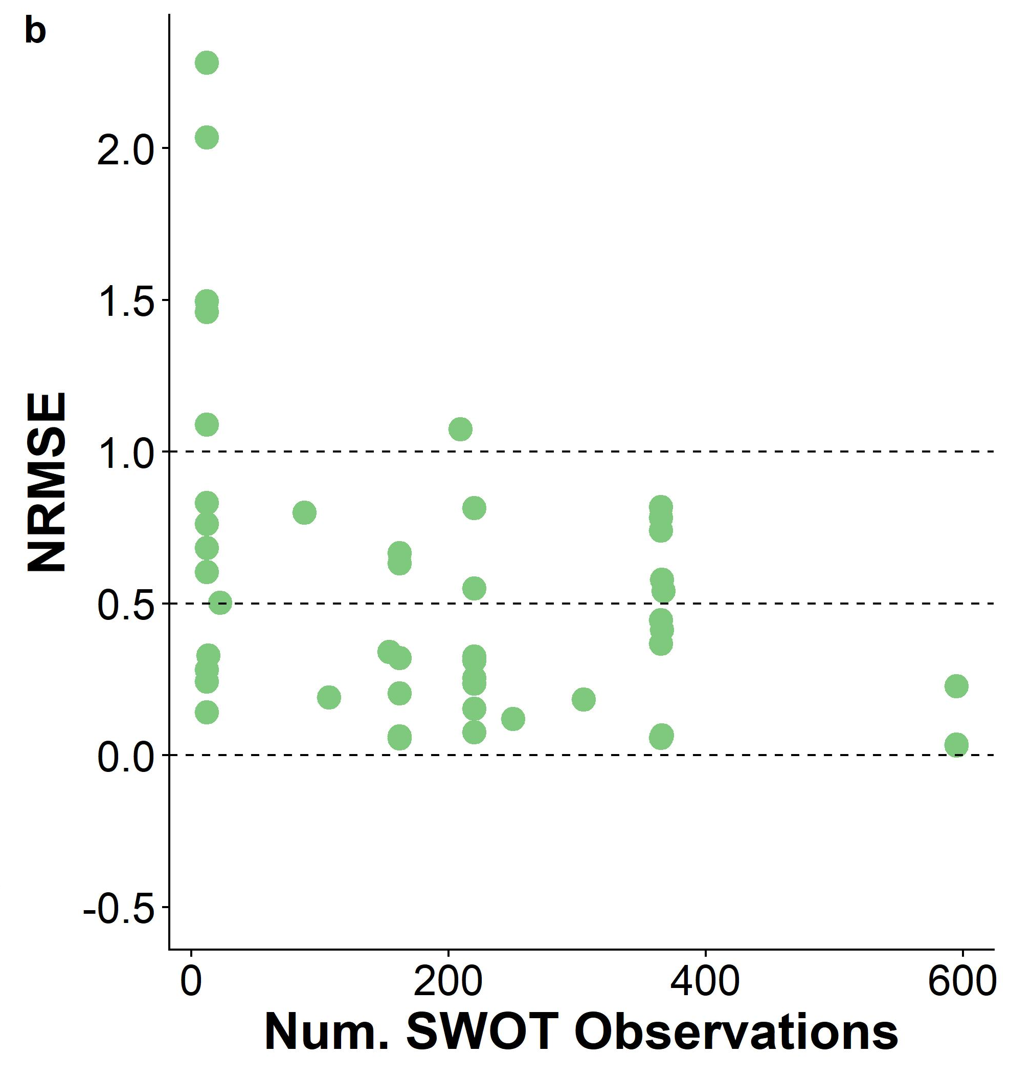
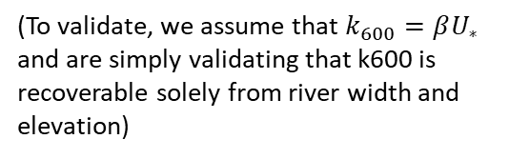
BIKER algorithm validated on 47 simulated SWOT rivers
No in situ info required, obtained from river width and slope only
Performance by river improves with more data, per Bayesian techniques
Couple the algorithm with in situ CO2 sensor to see how well we can reproduce the gas fluxes
(To validate, we assume that $k_{600}=βU_{∗}$ and are simply validating that k600 is recoverable solely from river width and elevation)

Slide 8
Picking a model for k in large rivers
The following analysis uses ~475,000 discrete hydraulic measurements I collected form USGS gauges (Brinkerhoff etal 2019) and the Ulseth etal 2019 dataset of river k600

Slide 9
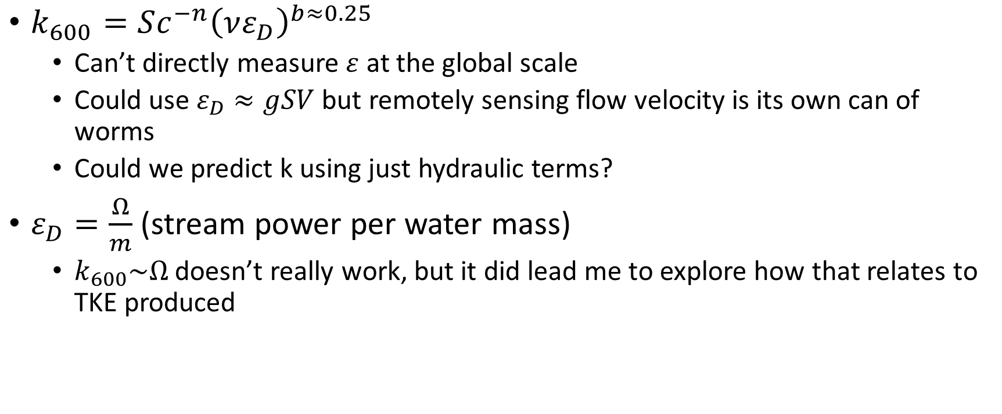
Original Idea
$k_{600}=Sc^{−n}{\left(νε_{D}\right)}^{b≈0.25}$
Can’t directly measure $ε$ at the global scale
Could use $ε_{D}≈gSV$ but remotely sensing flow velocity is its own can of worms
Could we predict k using just hydraulic terms?
$ε_{D}=\frac{Ω}{m}$ (stream power per water mass)
$k_{600}\sim Ω$ doesn’t really work, but it did lead me to explore how that relates to TKE produced

Slide 10
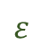
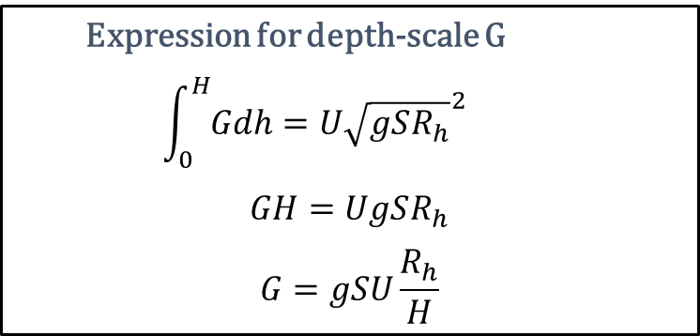
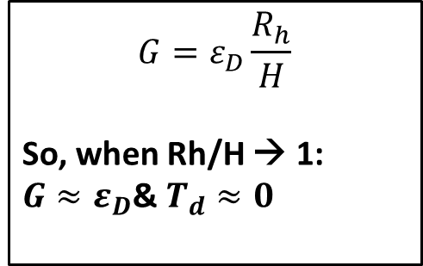
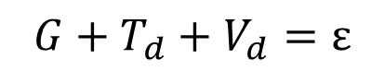
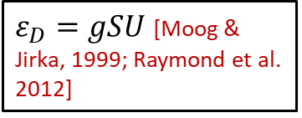
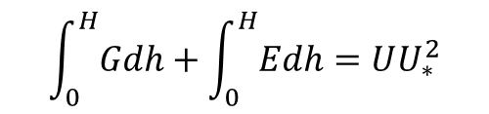
‘SWOT-river’ k model algebra
$$G+T_{d}+V_{d}=ε$$
Nakagawa & Nexu (1993) TKE budget (at free-surface) for an open-channel flow:
Nakagawa & Nexu (1993) also outline model for TKE produced at some depth in the water column:
$$ε$$
h=H
G
$$\int_{0}^{H}{Gdh}+\int_{0}^{H}{Edh}=UU_{∗}^{2}$$
Td
h=0
$ε_{D}=gSU$ [Moog & Jirka, 1999; Raymond et al. 2012]
$$G=ε_{D}\frac{R_{h}}{H}$$
So, when Rh/H → 1:
$G≈ε_{D}$& $T_{d}≈0$
Expression for depth-scale G
$$\int_{0}^{H}{Gdh}=U{\sqrt{gSR_{h}}}^{2}$$
$$GH=UgSR_{h}$$
$$G=gSU\frac{R_{h}}{H}$$

Slide 11
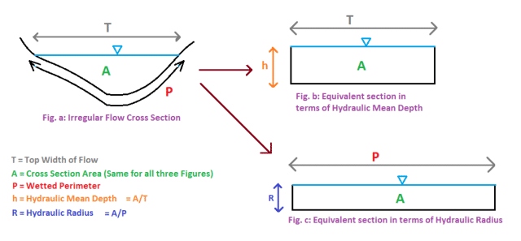
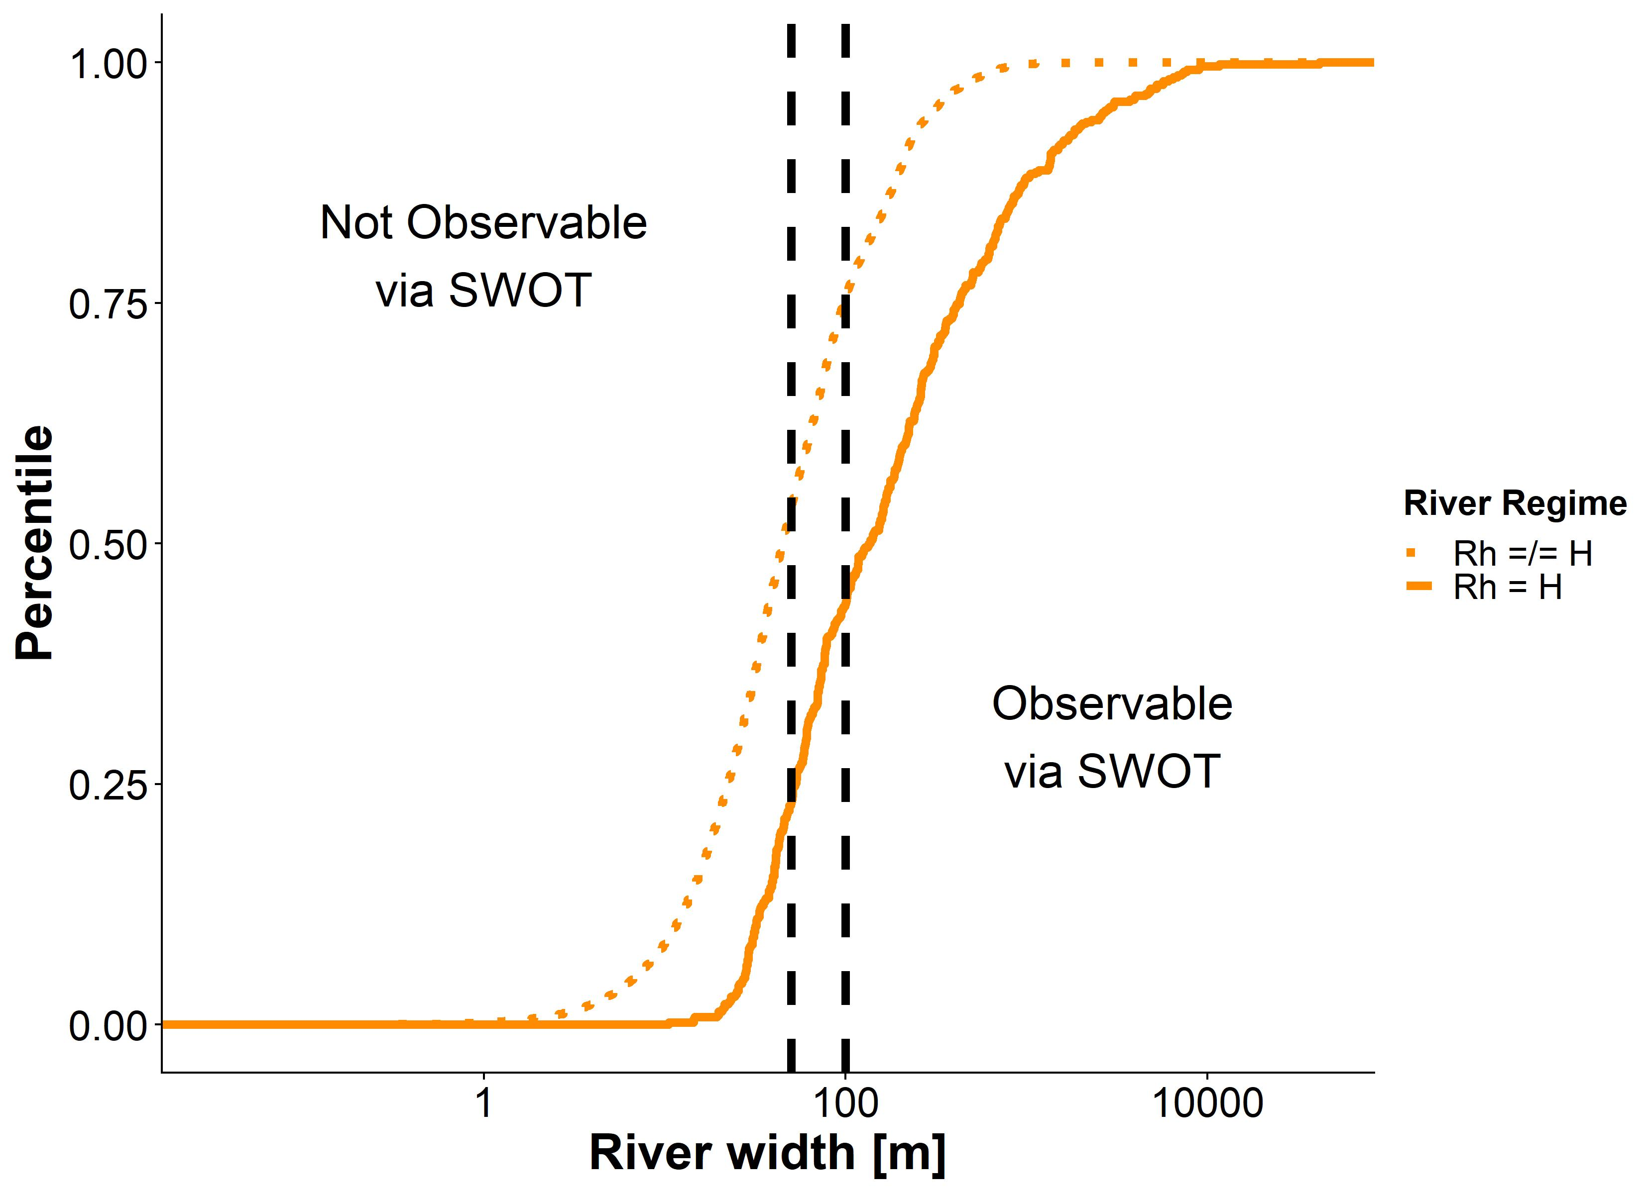
What is Rh (hydraulic radius)?
When a channel is much wider than it is deep, Rh → H
Happens in nearly all SWOT-observable rivers

Slide 12
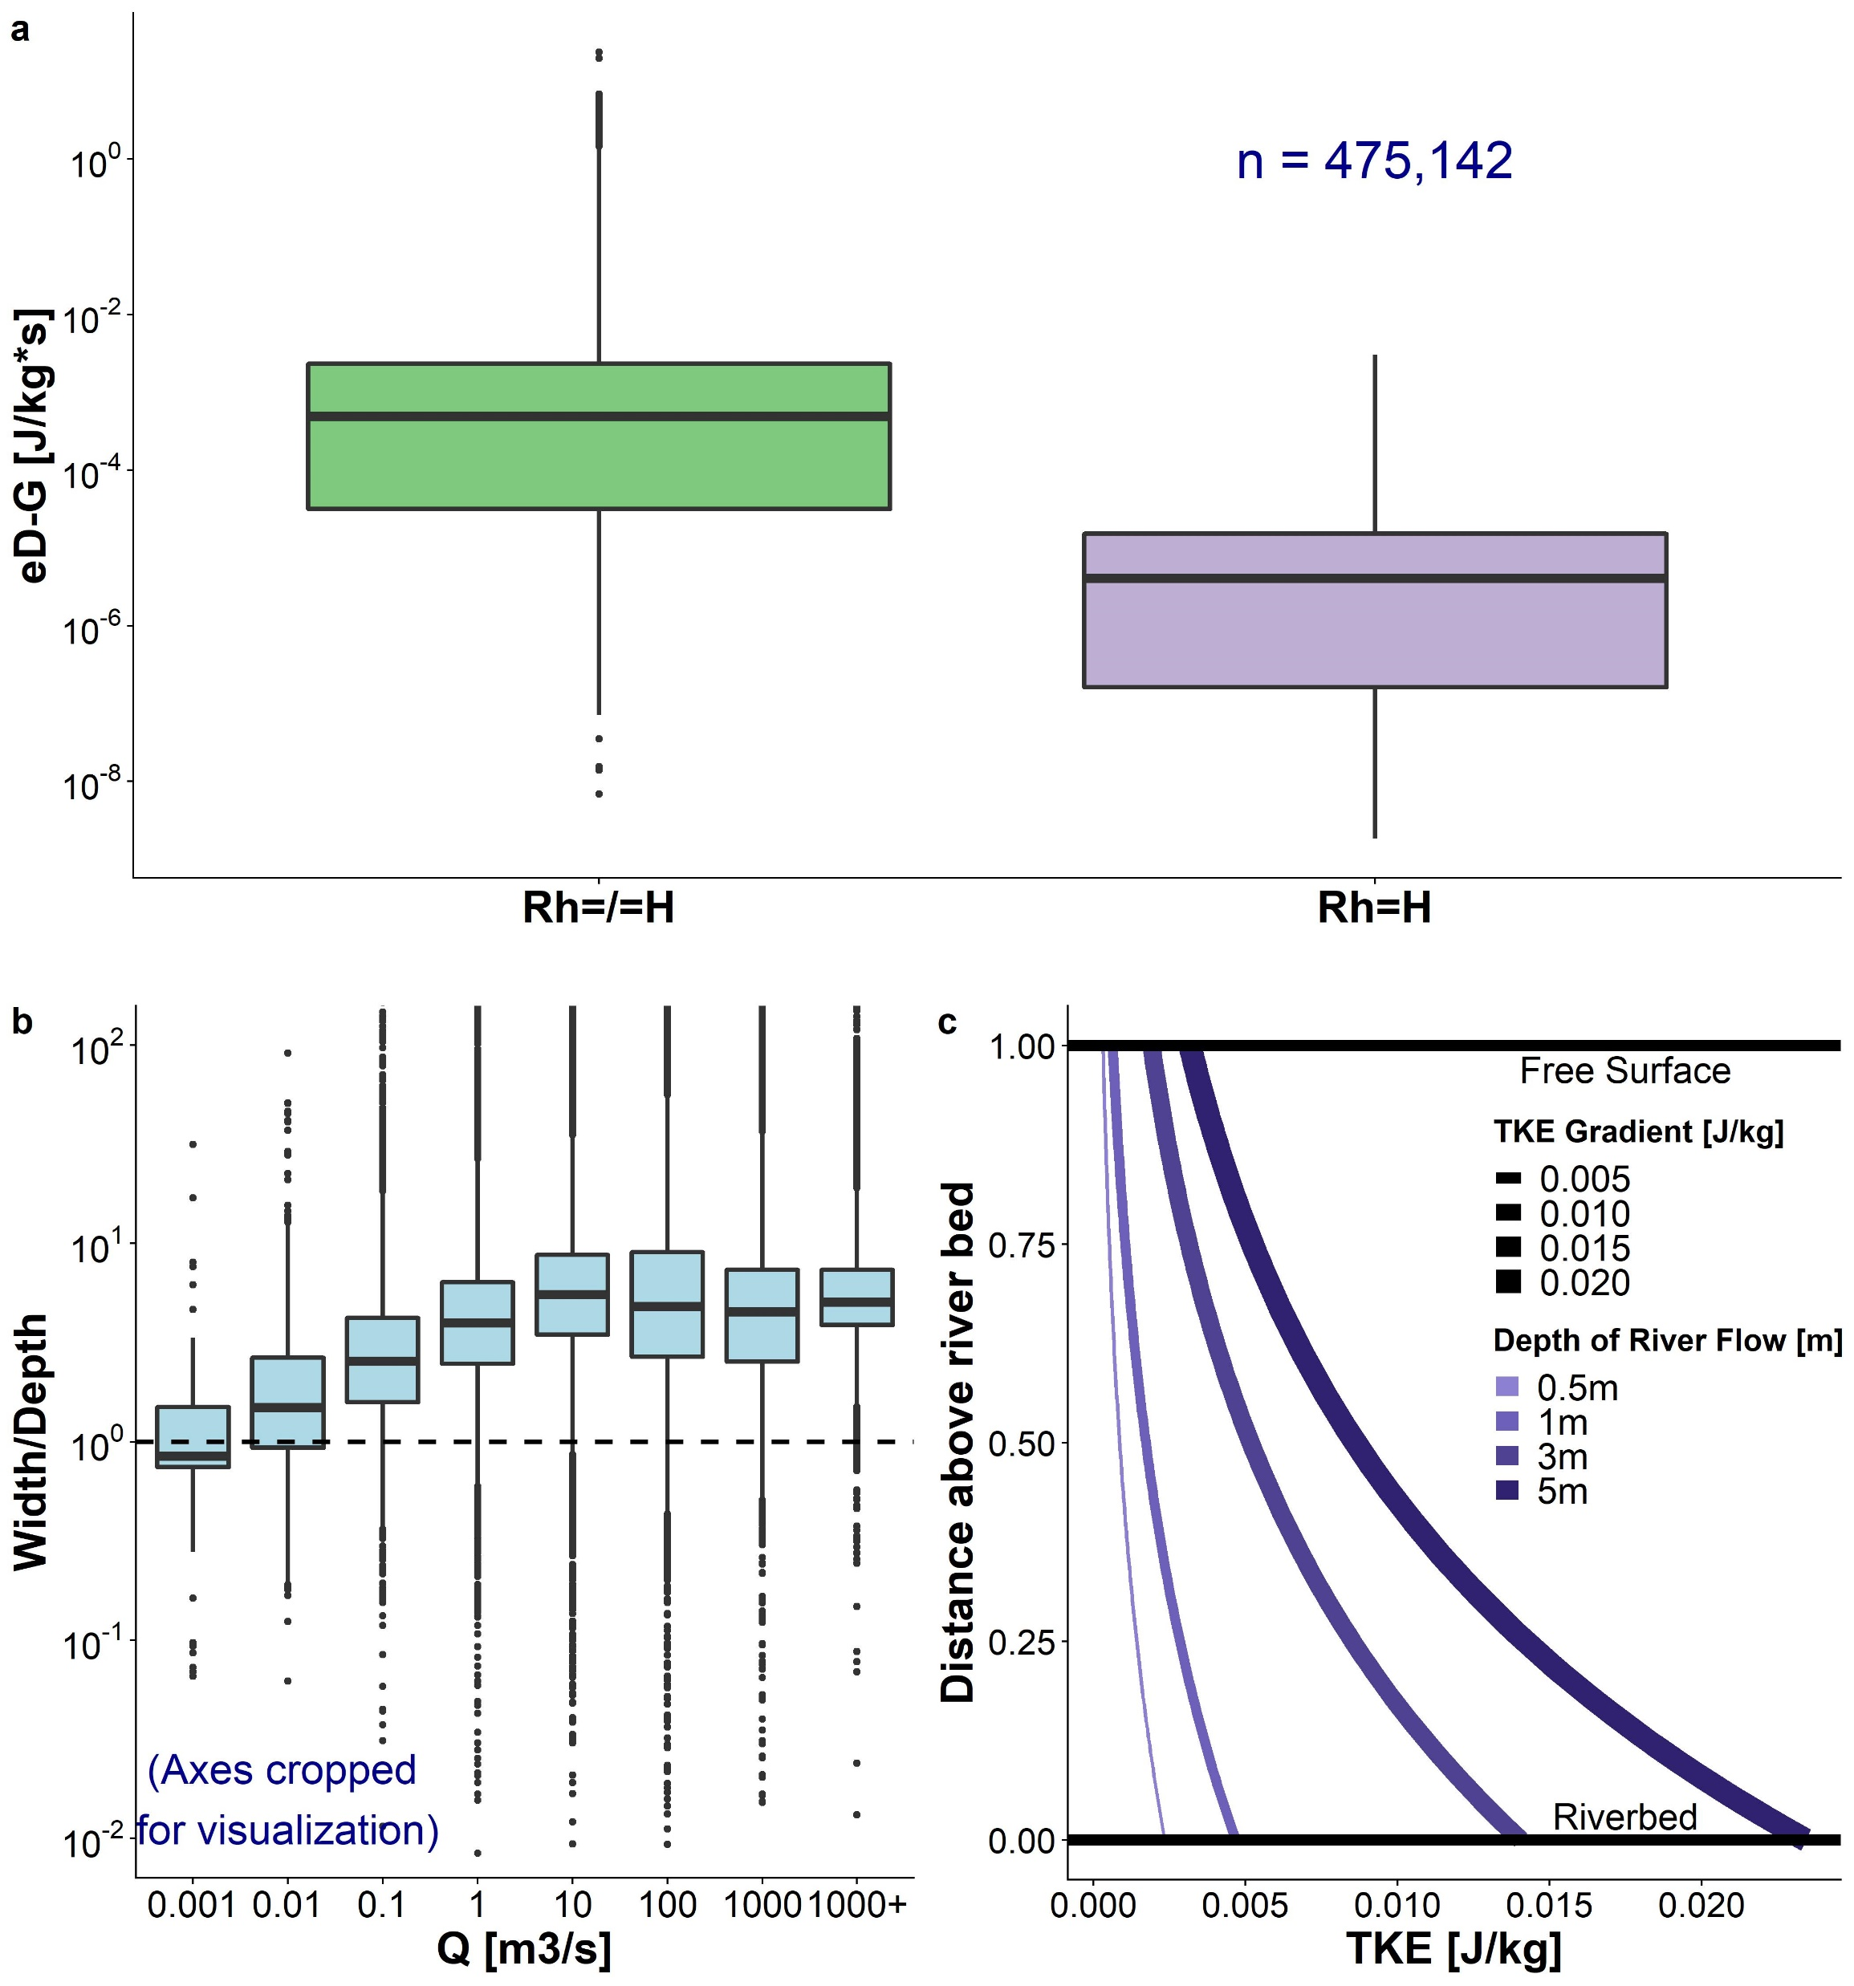
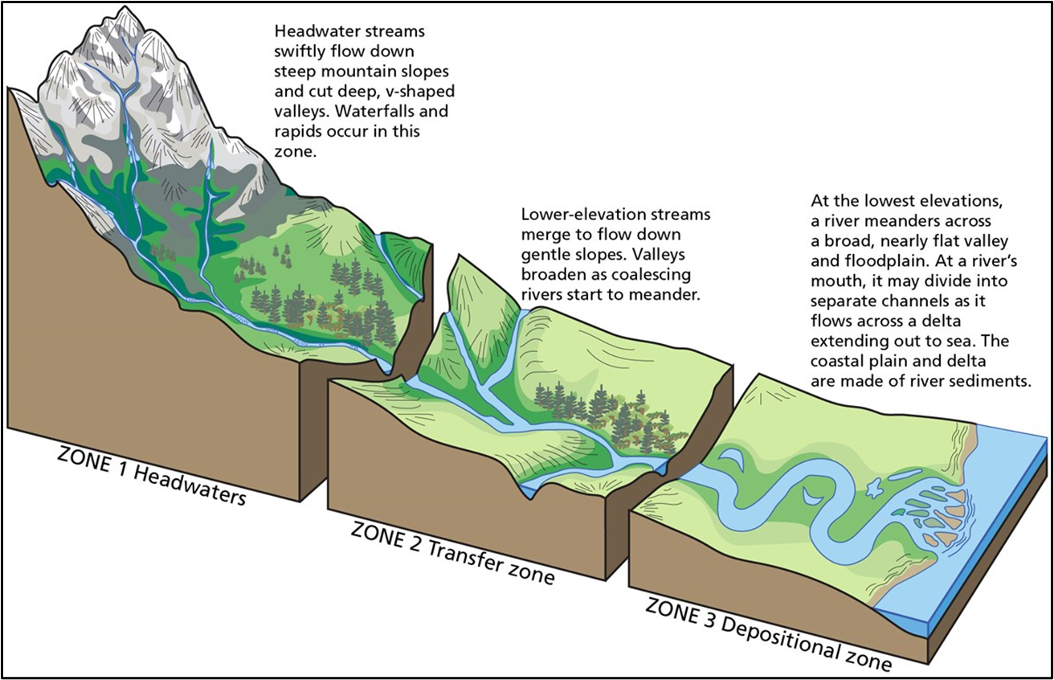
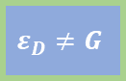
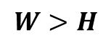

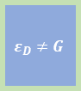
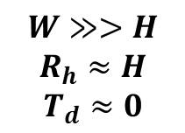
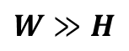

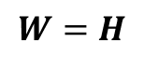


Empirical Validation
“Geomorphic model
of fluvial TKE”
2-4 orders of magnitude!
$$G+T_{d}=ε_{D}$$
$$G≈ε_{D}$$
If a flow is held constant, but depth decreases (and width subsequently increases), T_{d} decreases
Meaning a very wide, relative to depth, flow will have nearly no T_{d}
$$ε_{D}≠G$$
$$ε_{D}≠G$$
$$W=H$$
$$ε_{D}≠G$$
$$W>H$$
$$ε_{D}≈G$$
$$W≫H$$
$$W≫>H$$
$$R_{h}≈H$$
$$T_{d}≈0$$

Slide 13
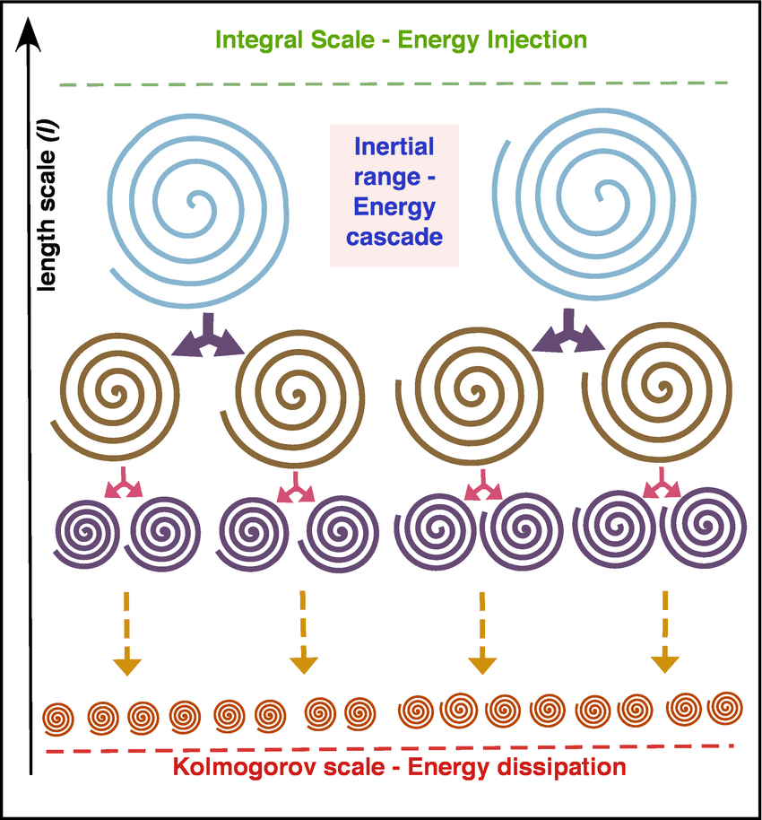
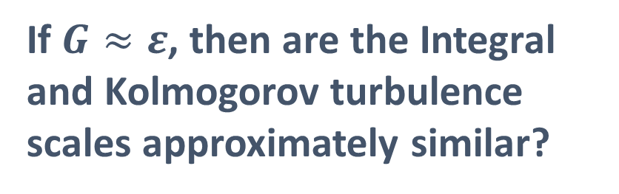
Who cares?
If $G≈ε$, then are the Integral and Kolmogorov turbulence scales approximately similar?
“idealized condition of a local equilibrium between
the production and dissipation of turbulent kinetic
energy in boundary-layer shear flow” [Lorke & Peeters 2006]
Integral scale velocity is FAR easier to measure via SWOT…

Slide 14
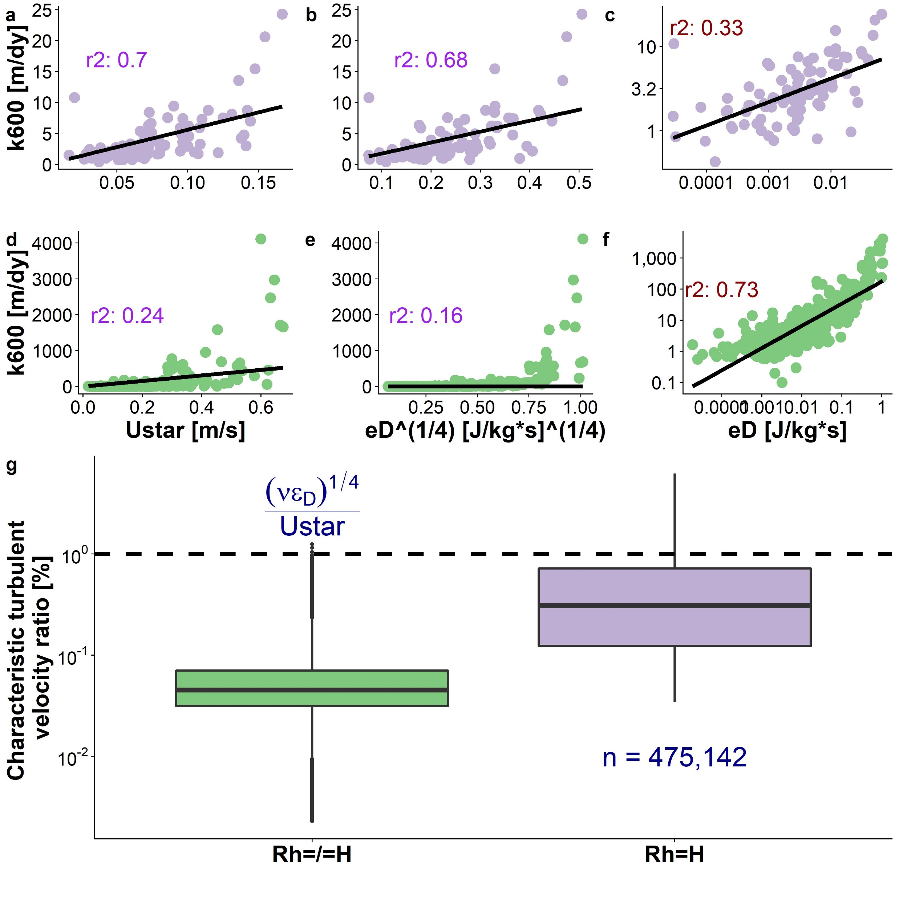
¼ exponent is statistically recovered here, which is really cool (~0.28)
~identical
Data from Ulseth et al. (2019)

Slide 15


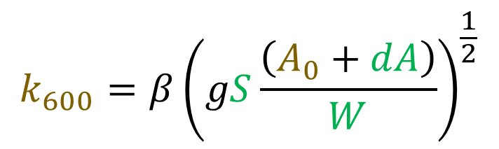
Implication for BIKER
$$k_{600}=βU_{∗}$$
$$k_{600}=β{\left(gSH\right)}^{\frac{1}{2}}$$
$$k_{600}=β{\left(gS\frac{\left(A_{0}+dA\right)}{W}\right)}^{\frac{1}{2}}$$
$$p\left(k_{600}, A_{0} | SWOT data\right)=\frac{f\left(SWOT data | k_{600}, A_{0}\right)p\left(k_{600}, A_{0}\right)}{p\left(SWOT data\right)}$$

Slide 17
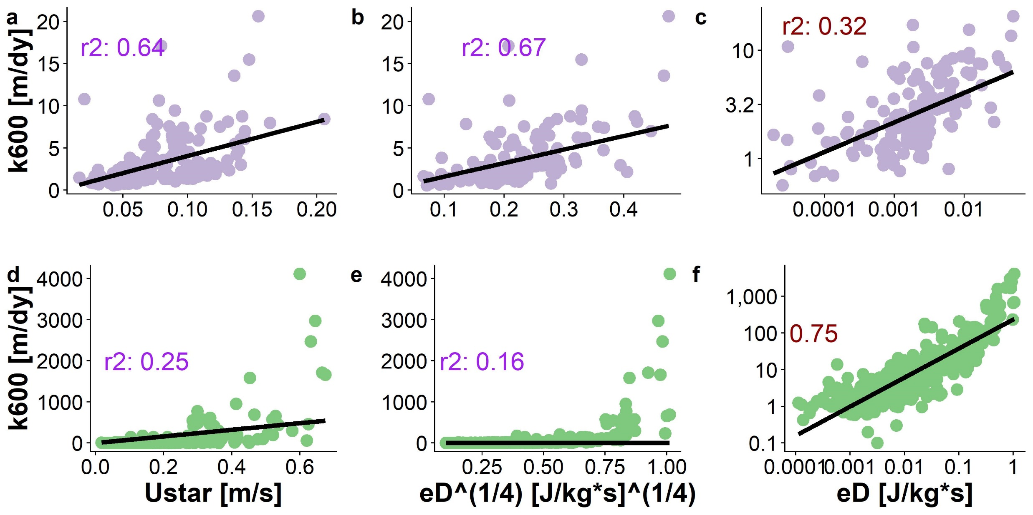
Fitting models by SWOT threshold

